Slide 1


“Jai Sri Gurudev” S J C INSTITUTE OF TECHNOLOGY DEPARTMENT OF INFORMATION SCIENCE AND ENGINEERING
Project work-21ISP76 - Review II
On
“AI Legal Assistant For Law Enforcement”
PRESENTED BY
Babureddy B N 1SJ21IS009
Irfan Khan I 1SJ21IS034
Mohammed Mazz 1SJ21IS059
Sridhara M 1SJ22IS401
UNDER THE GUIDANCE OF:
Mrs. Vindya L
ASSISTANT PROFESSOR
Dept. Of ISE, SJCIT

Slide 2
AI Legal Assistant For Law Enforcement
Contents:
DESIGN
IMPLEMENTATION
TESTING
RESULTS
CONCLUSION
BIBILOGRAPHY
Dept of ISE , SJCIT
2024-25

Slide 3
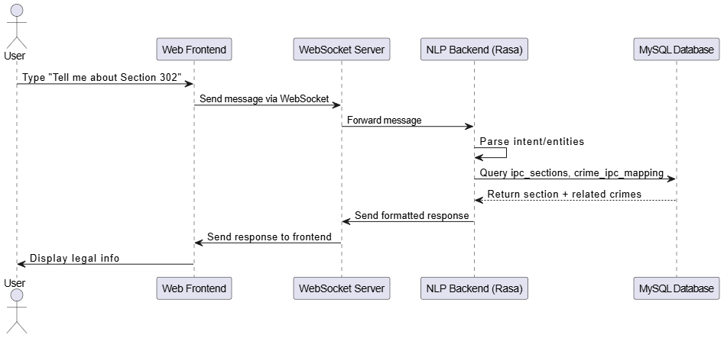
AI Legal Assistant For Law Enforcement
Design:
Fig 1: Sequence Diagram
Dept of ISE , SJCIT
2024-25

Slide 4
AI Legal Assistant For Law Enforcement
Design (Continue..)
User Request Flow
How the Chatbot Processes a User Query ?
User types a question like “Tell me about Section 302”.
The message is entered through the chatbot interface (web frontend).
The frontend sends this message to the WebSocket Server.
WebSocket Server acts as a bridge and forwards the message to the NLP Backend (Rasa).
The NLP system reads the message and understands the user’s intent.
It checks if the query needs legal data from the database.
Dept of ISE , SJCIT
2024-25

Slide 5
AI Legal Assistant For Law Enforcement
Design (Continue..)
Backend Logic and Final Response
How the Chatbot Responds ?
NLP backend queries the MySQL Database for section and crime details.
The database returns IPC section info and related crimes.
Rasa formats this data into a user-friendly legal reply.
WebSocket Server sends this response back to the frontend.
The chat interface shows the answer to the user.
User sees clear, structured legal information based on their query.
Dept of ISE , SJCIT
2024-25

Slide 6
AI Legal Assistant For Law Enforcement
Implementation:
PSEUDO CODE:
Frontend Interaction (User to Server)
1.Page Initialization:
- Load chat interface (HTML/CSS/JS)
- Connect to WebSocket server (ws://localhost:8080/ws)
2. User Input:
- Wait for user to type a crime-related message
- On "Send", display message and forward to server via WebSocket
3. WebSocket Server:
- Receive message from frontend
- Forward it to the NLP backend (Rasa)
Dept of ISE , SJCIT
2024-25

Slide 7
AI Legal Assistant For Law Enforcement
Implementation (Continue..)
NLP & Intent Handling (Rasa Logic)
4. Rasa NLP Backend:
- Process input using NLU pipeline
- Identify intent (e.g., ask_about_crime or ask_about_section)
- Extract relevant entities (e.g., "theft", "Section 302")
5. Custom Action Triggered:
- If intent = ask_about_crime → call action_query_crime
- If intent = ask_about_section → call action_query_ipc_section
Dept of ISE , SJCIT
2024-25

Slide 8
AI Legal Assistant For Law Enforcement
Implementation (Continue..)
Database Query and Final Response
6. Database Query (MySQL):
- Query crimes, ipc_sections, and crime_ipc_mapping tables
- Fetch IPC details, punishments, related crimes
7. Format Response:
- Build structured legal reply (title, description, section)
8. Response to User:
- Send response → WebSocket Server → Frontend
- Display legal info in chat window
Dept of ISE , SJCIT
2024-25

Slide 9
AI Legal Assistant For Law Enforcement
Testing:
Table 1 .Test Cases
Test Case ID | Description | Expected Result | Actual Result | Status
TC01 | User enters valid crime description | Bot identifies the crime and maps it to the correct IPC section | Bot identified crime and returned IPC section | Pass
TC02 | User enters unclear crime description | Bot asks follow-up questions | Bot asked clarifying questions | Pass
TC03 | User selects language option | Interface and responses change to selected language | Language changed successfully | Pass
TC04 | Crime is not in database | Bot responds with message and suggests manual review | Bot showed 'no match found' message | Pass
Dept of ISE , SJCIT
2024-25

Slide 10
AI Legal Assistant For Law Enforcement
Test Cases:
Test Case ID | Description | Expected Result | Actual Result | Status
TC05 | User input causes database error | Bot gracefully handles error and notifies user | Error handled and user notified | Pass
TC06 | User submits empty input | Bot prompts user to enter a valid description | Bot asked user to re-enter input | Pass
TC07 | Multiple users use the chatbot simultaneously | Bot handles concurrent sessions correctly | All sessions responded appropriately | Pass
TC08 | User uses unsupported language | Bot notifies user of unsupported language | User informed about unsupported language | Pass
TC09 | Database connection is lost during query | Bot shows error message and retries or exits gracefully | Bot showed error and retried | Pass
Dept of ISE , SJCIT
2024-25

Slide 11
AI Legal Assistant For Law Enforcement
Results:
Table 2.Performance Metrics:
Metric | Performance (%)
Accuracy (Crime to IPC) | 92.0%
Response Time (1–5 sec scale) | 4.5%
Follow-up Handling | 85.0%
User Satisfaction | 90.0%
Database Query Success | 98.0%
Dept of ISE , SJCIT
2024-25

Slide 12
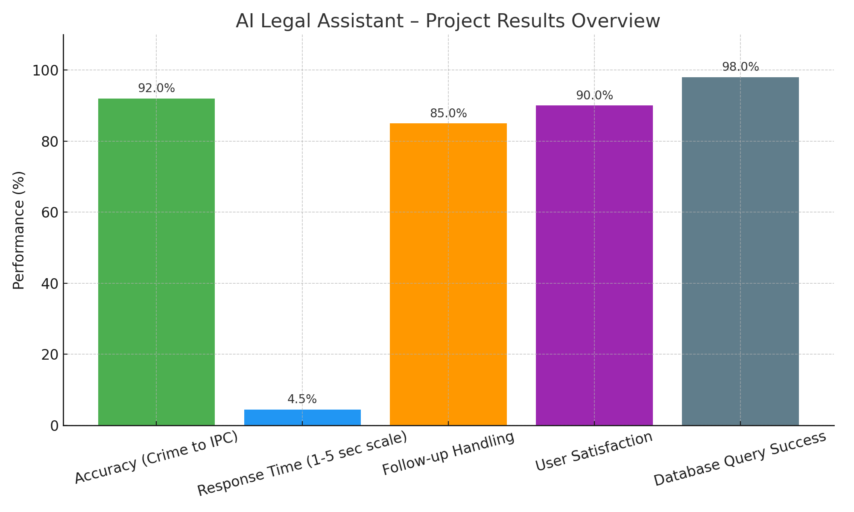
AI Legal Assistant For Law Enforcement
Results (Continue..)
Fig 2: Project Results Overview
Dept of ISE , SJCIT
2024-25

Slide 13
AI Legal Assistant For Law Enforcement
Results (Continue..)
High Accuracy – The AI correctly maps crimes to IPC sections 92% of the time.
Slow Response Time – The system is currently slow, scoring only 4.5% for speed.
Good at Follow-ups – It handles follow-up questions well, with 85% effectiveness.
Users Are Happy – User satisfaction is high at 90%.
Strong Database Performance – It successfully runs queries 98% of the time.
Dept of ISE , SJCIT
2024-25

Slide 14
AI Legal Assistant For Law Enforcement
Conclusion:
Helps Police Work Faster The chatbot makes it easier and quicker for officers to find the correct legal section for a crime.
Reduces Human Error By automating the process, it lowers the chances of mistakes in legal classification.
Saves Time and Effort Officers don’t have to manually search through legal books or websites.
Smart and Interactive The assistant understands crime descriptions and asks follow-up questions to get clear details.
Supports Legal Accuracy Ensures crimes are matched with the right IPC sections, improving the quality of justice.
Dept of ISE , SJCIT
2024-25

Slide 15
AI Legal Assistant For Law Enforcement
Bibliography:
[1] A. Selvi, V. Mounika, V. Rubika, and B. Uvadharanee, “COLLEGEBOT: Virtual Assistant System for Enquiry Using Natural Language Processing,” in Proc. 2nd Int. Conf. Intelligent Data Communication Technologies and Internet of Things (IDCIoT), 2024.
[2] A. Suresh and R. Kumar, “Artificial Intelligence in Legal Decision-Making: Opportunities and Challenges,” in Proc. IEEE Int. Conf. Smart Technologies (ICST), 2023.
[3] P. Kumar and M. Raj, “An AI-Based Framework for Crime Classification and Legal Advice Generation,” in Proc. Int. Conf. Computational Intelligence and Knowledge Economy (ICCIKE), 2022.
[4] N. Patel and M. Sharma, “Legal Document Analysis using NLP Techniques,” Int. J. Comput. Appl., vol. 182, no. 17, pp. 25–30, 2021.
Dept of ISE , SJCIT
2024-25

Slide 16

AI Legal Assistant For Law Enforcement
Dept of ISE , SJCIT
2024-25

